Slide 1
RUNGTA COLLEGE OF DENTAL SCIENCES AND RESEARCH
DEPARTMENT OF PERIODONTOLOGY FINAL YEAR BDS
PERIODONTAL MEDICINE
PRESENTED BY:
Dr. Aena Jain Pundir
Professor
Dept. of Periodontology

Slide 2
Contents
DIABETES MELLITUS AND PERIODONTAL DISEASE
PERIODONTAL DISEASE AND ADVERSE PREGNANCY OUTCOME
PERIODONTITIS AND COPD
PERIODONTITIS AND RHEUMATOID ARTHRITIS
SUMMARY
REFERENCES

Slide 3
Specific study objectives
Core areas | Domain | Category
Diabetes mellitus and periodontal disease | Affective | Desire to know
Periodontal disease and adverse pregnancy outcome | Cognitive | Must know
Periodontitis and COPD | Cognitive | Must know
Periodontitis and rheumatoid arthritis | Cognitive | Must know

Slide 5
Potential mechanisms involved in the pathogenesis of periodontitis in diabetes

Slide 6
Taylor JJ, Preshaw PM, Lalla E. A review of the evidence for pathogenic mechanisms that may link periodontitis and diabetes. J Clin Periodontol. 2013;40(Suppl 14):129.

Slide 7
Effect of Diabetes on periodontium
Poor periodontal outcomes result from hyperglycemia in diabetes due to changes in :
Micro-organisms
Host response
Wound healing
Blood vessels

Slide 8
Change in oral Microorganisms
SALIVARY FLUX REDUCTION
HIGH GLUCOSE CONC IN SALIVA & GCF
DEVELOPMENT OF PERIODONTOGENIC FLORA
Thus susceptibility of diabetics to periodontal disease is increased

Slide 9
Changes in Immune response
Function of neutrophils and monocytes altered
Neutrophil adherence,chemotaxis & phagocytosis impaired.
Thus periodontitis is aggravated
Monocytes & Macrophages often exhibit elevated production of inflammatory mediators, and this hyperesponsive state increases host tissue
destruction
.

Slide 10
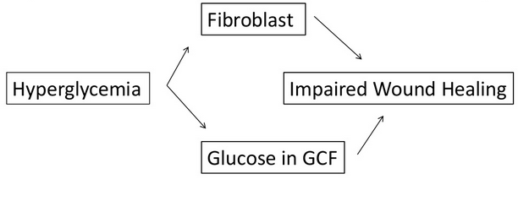
Altered wound healing
a)The fibroblast, does not function properly in high-glucose environments.
b) The collagen produced by these fibroblasts is susceptible to rapid degradation by MMP enzymes which are elevated in diabetes.
Wound healing responses to chronic microbial insult may be altered in those with sustained hyperglycemia, resulting in increased bone loss and attachment loss.

Slide 11
Change in microvascular Integrity

Slide 12
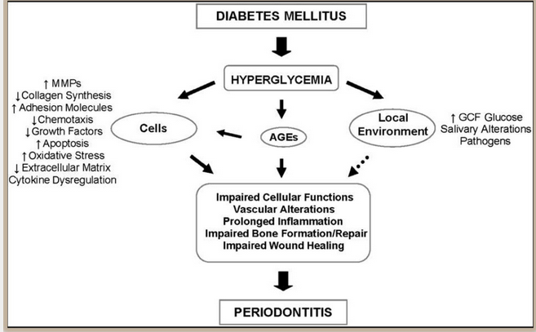

Slide 13
Effect of Diabetes on Periodontitis

Slide 14
MECHANISM BY WHICH PERIODONTAL DISEASE MAY INFLUENCE DIABETES
Acute Bacterial and Viral Infections
2
Chronic gram -negative periodontal infections, have significantly higher serum markers of inflammation, such as CRP,IL6 and Fibrinogen than subjects without periodontitis.
3
Periodontal treatment may reduce inflammation locally and also decrease the serum levels of the inflammatory mediators,that cause insulin resistance, thereby positively affecting glycemic control
1

Slide 15
Effect of Periodontal treatment on HbA1C Levels

Slide 16
“Overall, there is consistent and robust evidence that severe periodontitis, adversely affects blood
glucose levels expressed as HbA1C in individuals with and without diabetes.
Moderate-to-severe periodontitis is associated with an increased risk for the development of diabetes.Evidence supports a dose-dependent
role for periodontitis and diabetes complications.”
Chapple ILC, Genco R, and on behalf of working group 2 of the joint EFP/AAPworkshop. Diabetes and periodontal diseases: consensus report of the Joint EFP/AAP Workshop on Periodontitis and Systemic Diseases. J Clin Periodontol 2013;40 (Suppl. 14): S106–S112.

Slide 17
Periodontitis and Adverse Pregnancy Outcome

Slide 18
PERIODONTITIS & ADVERSE PREGNANCY OUTCOMES
Preterm birth – one of the most complicated and challenging issues in perinatal medicine
Spontaneous preterm birth – social (maternal race/ethnicity, poverty) and individual risk factors (underweight, tobacco use, maternal infection).
Periodontal disease occurs in 40% of pregnant women (Lieff et al.,2004)

Slide 19
PRE-TERM BIRTH LATE PRE-TERM BIRTH | birth <37wks gestational age birth at 34-36wks gestational age
VERY PRE-TERM (Martin et al.,2007) | Birth <32wks of gestational age
EXTREMELY PRE-TERM (Martin et al.,2007) | Birth <28wks gestational age
LOW BIRTH WEIGHT (WHO 2005) | <2500g
VERY LOW BIRTH WEIGHT (WHO 2005) | <1500g

Slide 20
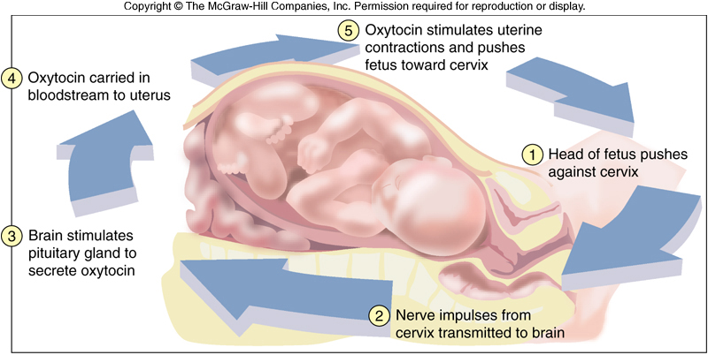
PHYSIOLOGY OF NORMAL LABOUR

Slide 21
ABNORMAL LABOUR

Slide 22
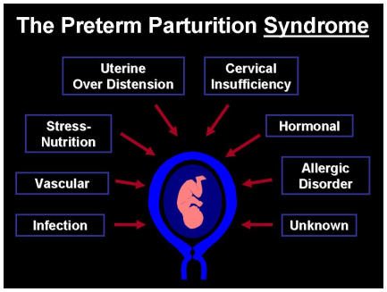
Psychosocial factors
Socio-economical factors
Demographic factors
S
c
h
n
e
i
d
e
r
e
t
al
2
0
0
6
Infections
Urinary passage
Systemic
Ascending
Chrionammionitis
Disorganization of placentation
Preeclampsia
Placenta praevia
Abruptio placentae
Preterm labour
Premature rupture of membranes
Medical induced interruption
Fetal pathology
Deformities
Chromosomal abnormalities
Allo-immunopathies
Uterus pathology
Deformities
Myoma
Cervix insufficiency
Multiple
pregnancies

Slide 23
Proposed hypothetical model of the association between periodontal disease and adverse pregnancy outcomes (Ann Acad Med Singapore 2005)
Infection (bacterial vaginosis, Periodontitis)
Endotoxin/microbiological products
Inflammation
Pro-inflammatory mediator activation
IL-1,TNF-alpha,MMPs
Fetal toxicity
Pre-term low birth weight
Fetal growth restriction

Slide 24
Systematic review on periodontal disease & pre-eclampsia (Alina Kunnen et al.,2010)
A generalized inflammatory response plays an important role in the pathogenesis of pre-eclampsia; periodontal disease might contribute to its pathogenesis.
Questionable role of periodontal disease
None of RCTs till date reported reductions in pre-eclamptic rate after periodontal therapy during pregnancy.
Larger RCTs – required to explore causuality and biologic mechanism.

Slide 25
Effect of Periodontal therapy on Adverse Pregnancy outcome

Slide 26
“Although periodontal therapy has been shown to be safe and leads to improved periodontal conditions in pregnant women, case-related periodontal therapy, with or without systemic antibiotics does not reduce overall rates of pre-term birth and low birthweight.”
Sanz M, Kornman K; Working group 3 of joint EFP/AAP workshop. Periodontitis and adverse pregnancy outcomes: consensus report of the Joint EFP/AAP Workshop on Periodontitis and Systemic Diseases. J Clin Periodontol. 2013 Apr;40 Suppl 14:S164-9.

Slide 27
Periodontitis and Respiratory diseases

Slide 28
Pneumonia is the inflammation of lung tissues followed by the accumulation of blood cells, fibrin & exudates in the alveoli
COPD is characterized by chronic obstruction to airflow with excess production of sputum resulting from chronic bronchitis (CB) and or emphysema.
Chronic bronchitis is defined as a condition associated with excessive tracheo-bronchial mucus production to cause cough with expectoration for at least 3 months of the year, for more than 2 consecutive years.
Emphysema is defined as the distention of the air spaces distal to the terminal bronchiole with destruction of the alveolar septa

Slide 29
VAP – pneumonia developing in 48hrs or more after initiation of mechanical ventilation
HAP – pneumonia with an onset 48hrs or more after admission to the hospital
Scannapieco’s report (1992) – oral and/or periodontal infection may increase the risk for bacterial pneumonia or COPD

Slide 30
Etiopathogenesis

Slide 31
Four important mechanisms have been proposed to explain, how oral bacteria can participate in the pathogenesis of respiratory infection.
1. Oral pathogens may be aspirated into the lung.
2. Enzymes in the saliva, which are associated with periodontal disease, may modify mucosal surfaces to promote adhesion and colonization by respiratory pathogens.

Slide 32
3. Periodontal disease associated enzymes may destroy salivary pellicles on pathogenic bacteria.
4. Cytokines released during periodontal disease process may alter respiratory epithelium to promote infection by respiratory pathogens
Scannapieco FA ,Role of Oral Bacteria in Respiratory Infection, J Periodontol 70, 1999, 793-802 .

Slide 33
Aspiration of bacteria from oral cavity
Entry into upper airway & lungs
Failure of host defense to clear bacteria
Lung infection
VAP Bacteria adhere to endotracheal
tube surface
Growth of biofilm
Biofilm dislodged & embolize distally to set up foci of infection

Slide 34
COPD
“An association with periodontitis is suggested based on analyses of the NHANES data sets. There appears to be a dose effect, whereby greater periodontal disease is associated with
increasing loss of lung function.
The primary aetiological factor is smoking as modified by underlying inflammation.
Studies of the association between periodontal disease and exacerbations of COPD would be
valuable.”

Slide 35
Pneumonia
“The association between dental plaque and pneumonia appears to be stronger than for plaque and COPD. That improved oral hygiene reduces the risk of health care-associated
pneumonia is suggested by several meta-analyses. The relationship with periodontitis however is not known.”
Linden JG ,Herzberg MC, Periodontitis and systemic diseases:a record of discussion of working group 4 of the Joint EFP/AAP Workshop on Periodontitis and Systemic Diseases , J Periodontol , 84(4 suppl.), 2013, S20-3.

Slide 36
Periodontitis & Rheumatoid arthritis

Slide 37
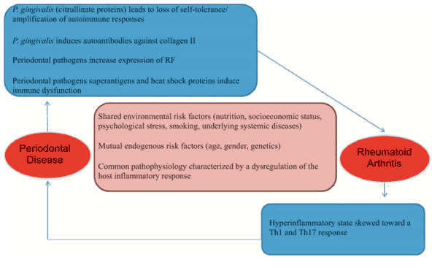

Slide 39
The area of lavendar overlap indicates similarities in clinical and pathological features between Rheumatoid arthritis and periodontitis.
Dimensions of dental hygiene March 2008

Slide 40
Biological plausibility for an association with periodontitis is also reflected in the
detection of citrullinated proteins in inflamed gingiva, which may be associated with elevated auto-antibodies to self-antigens (Nesse et al 2012)

Slide 41
Periodontitis and Chronic Renal Disease

Slide 43
Oral manifestations of CKD

Slide 44
Effect of Periodontitis on CKD
1. Systemic inflammation due to periodontitis can affect the kidneys
2. Bacteria from plaque can invade the endothelium of kidney forming atheromatous lesions, thus decreasing blood flow to the organ
3. CRP Levels ↑ and levels of albumin in blood↓
Arsalan Wahid, Saima Chaudhry, Afifa Ehsan, Sidra Butt, Ayyaz Ali Khan
Bidirectional Relationship between Chronic Kidney Disease & Periodontal Disease .Pak J Med Sci. 2013 Jan-Mar; 29(1): 211–215

Slide 45
“The association between chronic kidney
disease (CKD) and periodontitis in several studies is statistically significant and consistent. Although hypertension and diabetes are the primary aetiological factors, periodontitis is hypothesized to modify both these aetiological factors and consequently the presentation of
CKD.”

Slide 46
Periodontitis and Stress

Slide 47
“Many clinical studies of obesity and periodontal disease have been reported including a number of systematic reviews. There are a few prospective studies indicating an association with periodontitis. More specifically, the literature suggests
that obesity might adversely affect periodontitis, but there is little evidence
from clinical data or for biological plausibility that periodontitis may affect obesity.”

Slide 48
“Prospective and case-control studies suggest an association between periodontitis and oral and oro-pharyngeal
cancer. Whereas some oral microbes can alter cells and tissues consistent with features of malignant changes, additional biological plausibility, clinical and robust epidemiological data are needed to strengthen such associations.”

Slide 49
SYSTEMIC DISEASES ASSOCIATED WITH PERIODONTAL DISEASE
Alzheimers disease
Aneamia
Atheroschlerosis
Auto-immune disease
Cancer
Chronic obstructive pulmonary disease
Colon cancer
Crohns disease
Death
Dementia
Diabetes
Dry mouth
Endometriosis
Erectile dysfunction
Fatigue
Fever
Fibromyalgia
Gastro-oesophageal reflux disease
Hypertension
Infertility
Inflammatory bowel disease
Intellectual function
Leukemia
Low birth weight
Lung cancer
Lupus
Metabolic syndrome
Miscarriage
Mouth cancer
Multiple sclerosis
Obesity
Obstructive sleep apnea
Osteoporosis
Pneumonia
Polycystic ovaries
Pre-eclampsia
Premature birth
Psoriasis
Renal disease
Rheumatoid arthritis
Stroke
Stomach ulcers
Mark Bartold Editor, Australian Dental Journal ,2012

Slide 50
Summary
Thus these and other criteria have to be fulfilled for a link between Periodontitis and other systemic diseases.
As of now the evidence is weak, many longitudinal interventional studies have to be conducted and substantial evidence gathered, to uphold earlier research about periodontal medicine.

Slide 51
References
Newman MG, Takei HH, Klokkevold PR, Carranza FA. Carranza’s clinical periodontology, 10th ed. Saunders Elsevier; 2007.
Lindhe J, Lang NP and Karring T. Clinical Periodontology and Implant Dentistry. 6th ed. Oxford (UK): Blackwell Publishing Ltd.; 2015.

